Slide 1
ELL 212 Why Study Electromagnetics?
Uday Khankhoje Electrical Engineering IIT Delhi, 2015-16 Sem 2

Slide 2
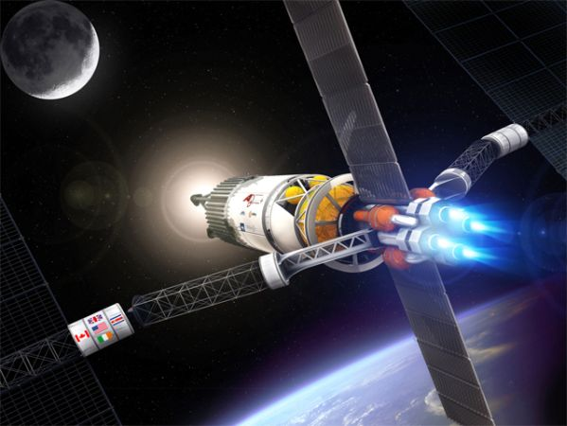
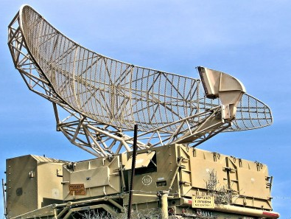
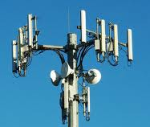
Why Study Electromagnetism?
Plasma propulsion
Radars
Cell towers
Optical
fibres

Slide 3
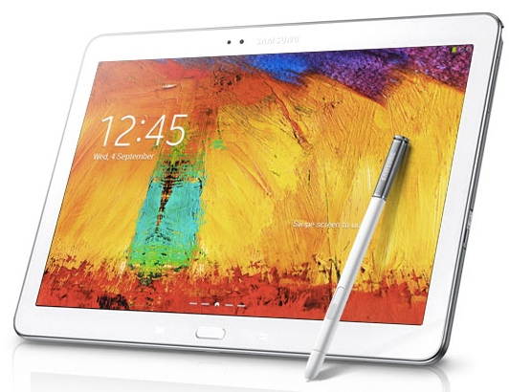
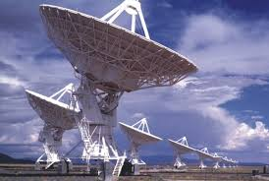
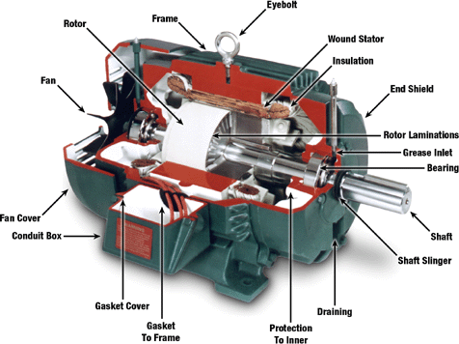
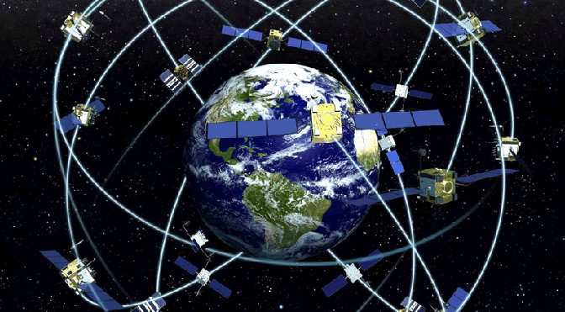
Why Study Electromagnetism?
LCD screens
Radio astronomy
GPS
Motors

Slide 4
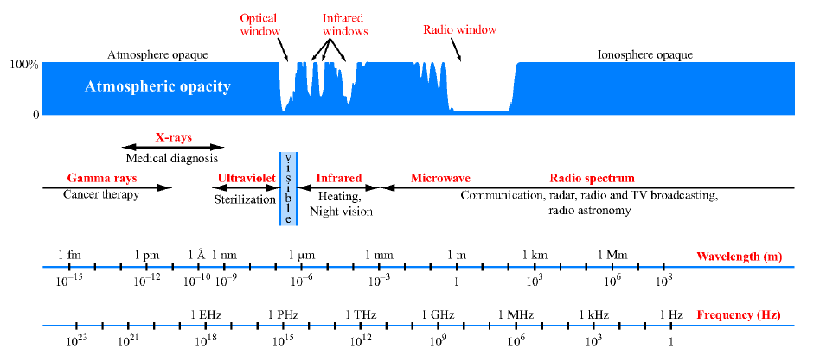
Electromagnetic Spectrum
[8]

Slide 5
EM Applications over time
1900 – 1990s: Dominated by military applications – Radar, stealth technology, electromagnetic weapons, etc.
1990s – today:
Computing
Communication
Imaging (bio-medical, remote-sensing, ground-penetrating radar, oil well exploration, etc.)

Slide 6
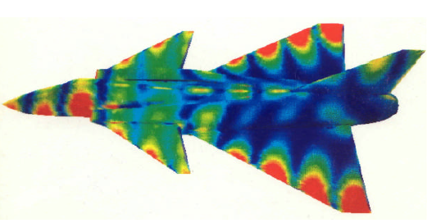
Military applications
[1]
100 MHz radar wave interacts with a fighter jet. False colours correspond to induced surface currents which re-radiate EM energy

Slide 7
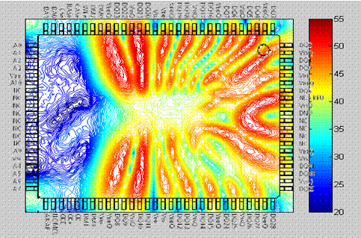
High-speed circuits
Circuit theory is actually a subset of electromagnetic field theory: At high switching speeds, signals are not confined to circuit paths!
Shrinking circuit size + high speed operation => Higher coupling between circuit elements via EM
Near magnetic field above a packaged integrated circuit.[2]

Slide 8
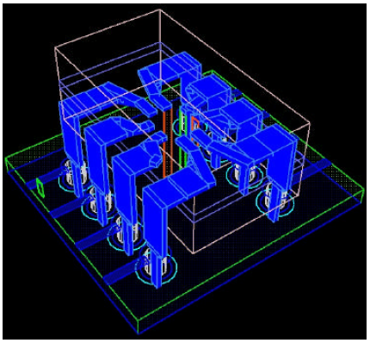
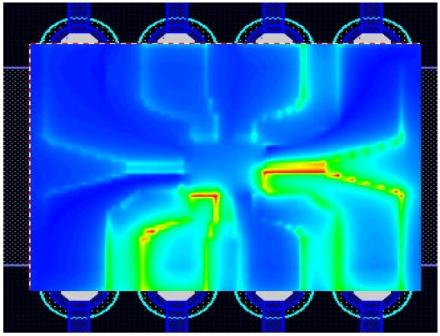
High-speed circuits
Microchip embedded within a dual inline IC
[1]
Fields associated with a logic pulse are not confined to metal paths

Slide 9
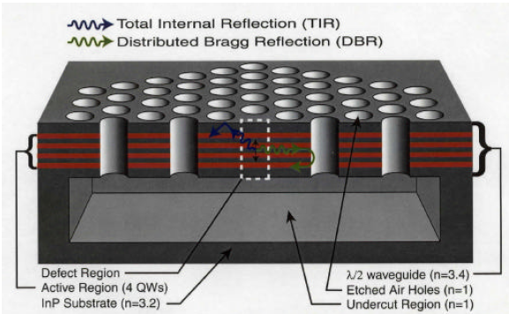
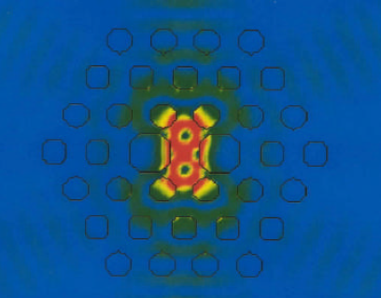
Micro-cavity Laser Design
Periodic air holes in a slab – Photonic Crystal
Simulation showing trapped electro-magnetic fields
[7]
Used for making ultra-compact lasers, quantum-entanglement devices, etc.

Slide 10
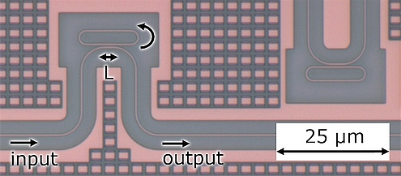
Photonic integrated circuits
[5]
Circuits for light : simple example of a wavelength dependent filter. At the resonance frequency of the loop, output drops off.

Slide 11
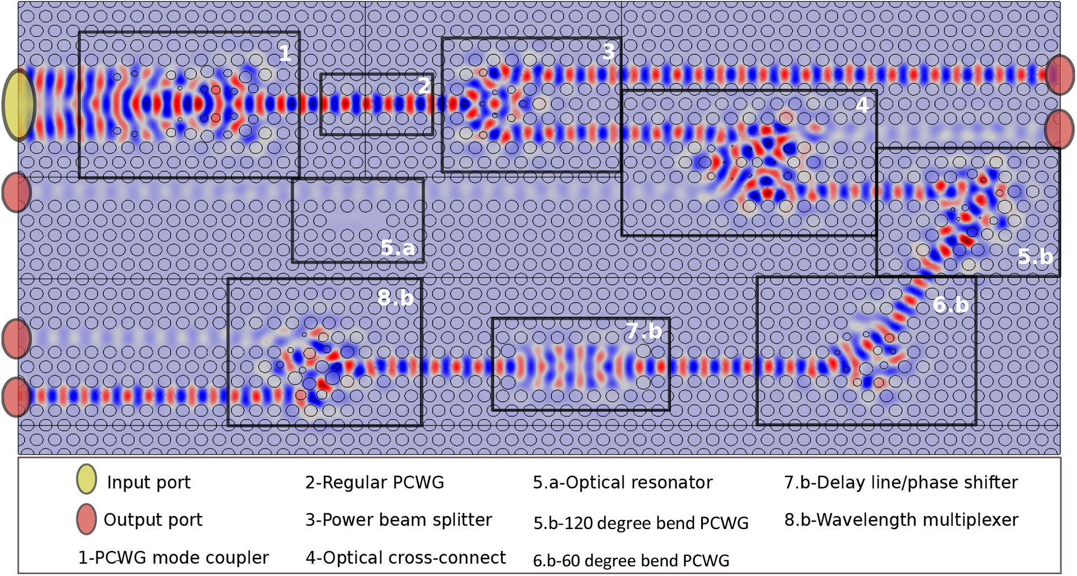
Photonic integrated circuits
[6]

Slide 12
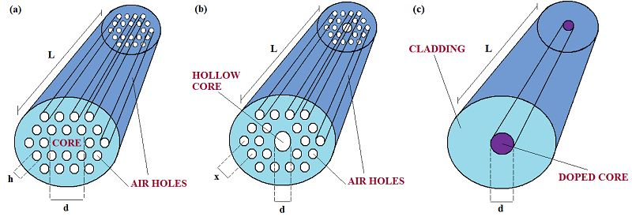
Optical Fibres
[4]
Photonic crystal fibres
Conventional fibres
In addition to simply guiding light, gives control over dispersion, polarization properties, non-linear effects, etc.

Slide 13
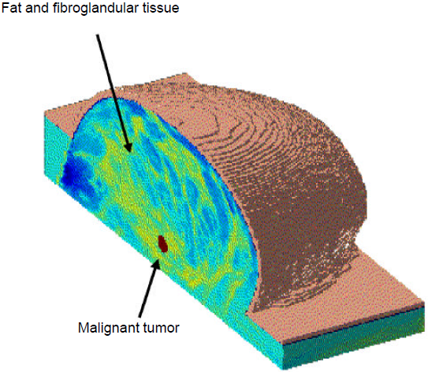
Human Body Imaging : medicine
Tumour region has different refractive index as compared to surrounding fatty tissue
[1]
Surround the tissue by antennas: properties of the scattered electro-magnetic energy depends on refractive index distribution
Reconstruct refractive index profile based on scattered electro-magnetic fields

Slide 14
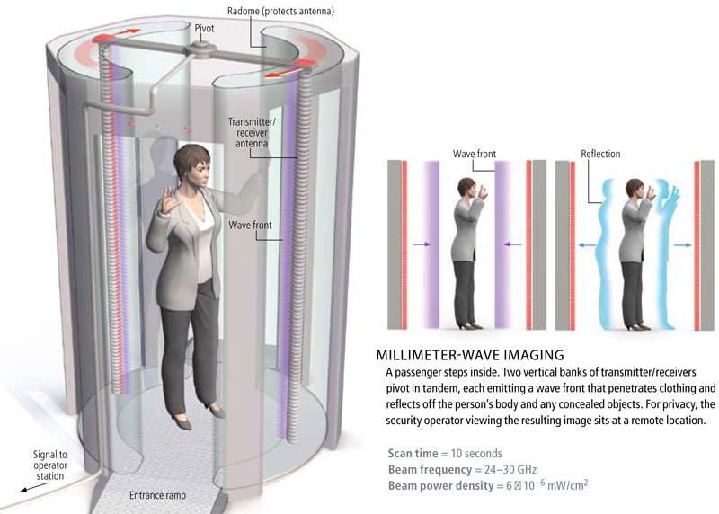
Human Body Imaging : security
Very active area of research : terahertz frequency (millimetre wavelength) sources and detectors.
[3]

Slide 15
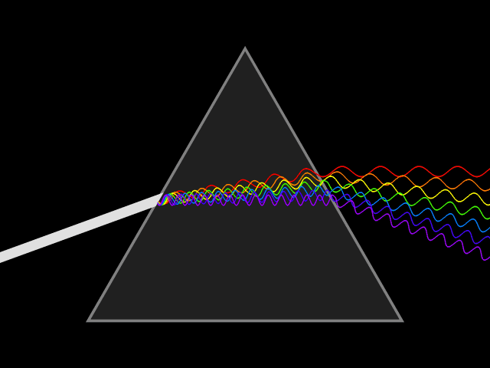
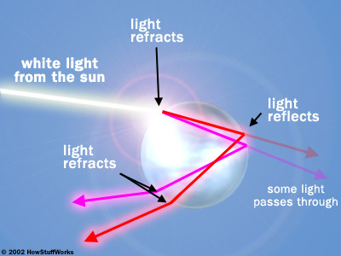
Natural Phenomena: rainbow!
http://www.srh.noaa.gov/jetstream/clouds/color.htm http://www.naturphilosophie.co.uk/rainbows-rainbows-everywhere/ http://science.howstuffworks.com/nature/climate-weather/storms/rainbow2.htm

Slide 16
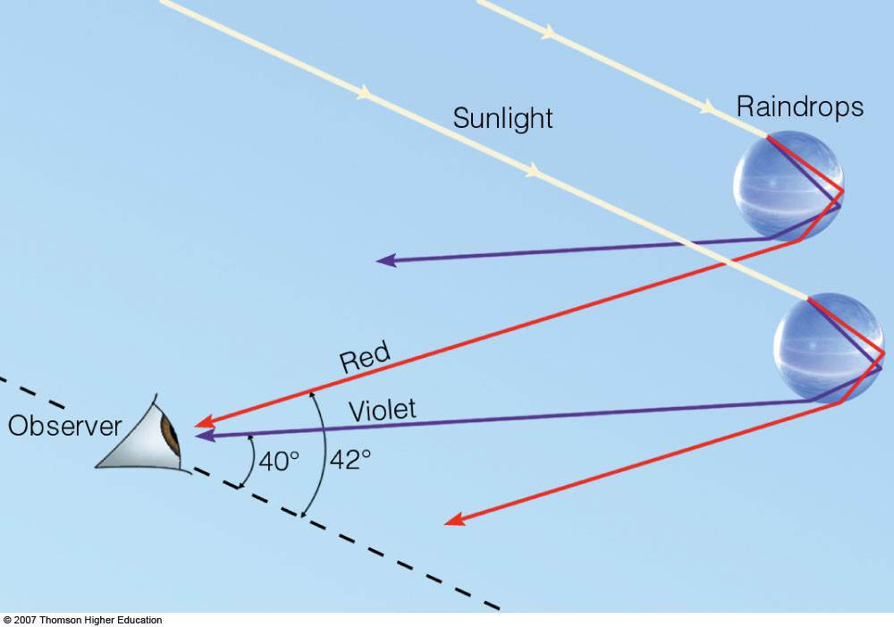
Natural Phenomena: rainbow!

Slide 17
Conclusions
Study of EM is fundamental to most applications of computing, circuit design, and communications
Many prominent future technologies are highly dependent on a sound understanding of EM: quantum computing, high-speed optical inter-connects, wireless power transfer

Slide 18
References
[1] Taflove, Allen. "Why study electromagnetics: the first unit in an undergraduate electromagnetics course." Antennas and Propagation Magazine, IEEE 44.2 (2002): 132-139.
[2] http://www.cvel.clemson.edu/emc/ic_emc/ic.html
[3] http://projektas-kalejimai.blogspot.in/2011_11_01_archive.html
[4] http://www.intechopen.com/books/advances-in-photonic-crystals/photonic-crystals-for-optical-sensing-a-review
[5] http://www.tnw.tudelft.nl/en/about-faculty/departments/imaging-physics/research/researchgroups/optics-research-group/research/integrated-photonics/
[6] Imanol Andonegui and Angel J. Garcia-Adeva. “Designing integrated circuitry in nanoscale photonic crystals” http://spie.org/x104683.xml
[7] O. Painter, R. K. Lee, A. Scherer, A. Yariv, J. D. O’Brien, P. D. Dapkus, and I. Kim, “Two-dimensional photonic band-gap defect mode laser,” Science, vol. 284, June 11, 1999, pp. 1819–1821.
[8] Ulaby, Michielssen, Ravaioli, “Fundamentals of Applied Electromagnetics”, Pearson 6th ed.

Slide 19
Course Topics
Transmission Lines
Review of vector calculus
Electrostatics
Electrodynamics
Electromagnetic waves
Guided waves
Special topics/guest lectures
The EM of rainbows
Photonic crystals
Antennas
Satellite Remote Sensing
Computational methods

Slide 20
Course Outline
Components
Quiz : 9%
Minor-1 : 18%
Minor-2 : 18%
Major : 30%
Poster Day : 20%
Attendance: 5%
Relative grading in 1,2,3,4
75% attendance req.
Exams will be closed notes, but “cheat” sheets will be allowed. On these sheet(s), you can write *anything*
Severe penalties for plagiarism/cheating
Attending tutorials essential to doing well

Slide 21
Frequently Asked Questions
How are the exams?
old style JEE, i.e. conceptual in nature, difficult if you mug last minute!
How to meet me if you have doubts?
Walk in: Wed 3-4p in my office Block-2/402B (a prior e-mail will be nice). For meeting at other times, see my webpage for details
Course information?
The course website will be constantly updated.
Tutorials?
Will be 3 or 4 times a week.
Recommended books?
Griffiths (main) and Ulaby (supplementary) Plenty of web material will be given.

