Slide 1
Electromagnetic Resonators
ELL212: Uday Khankhoje EE, IIT Delhi

Slide 2
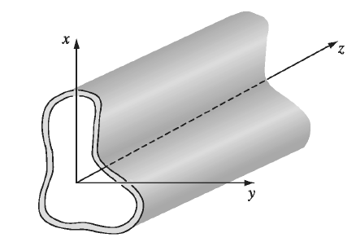
Waveguides (recap)

Slide 3
Waveguides (recap) [1]
Maxwell:
Expand fields into components:
$$\vec{E}\left(x,y,z,t\right)={\vec{E}}_{0}\left(x,y\right) e^{j\left(ωt−kz\right)}$$
$${\vec{E}}_{0}=E_{x} \hat{x}+E_{y} \hat{y}+E_{z} \hat{z}$$

Slide 4
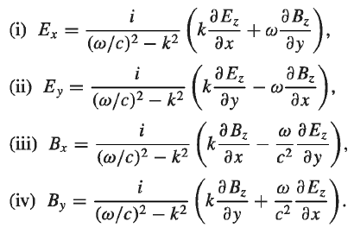
Waveguides (recap) [1]
Transverse components in terms of Ez, Bz:
(Note: replace i by –j above)

Slide 5
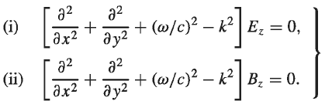
Waveguides (recap) [1]
Solve for Ez, Bz from here:

Slide 6
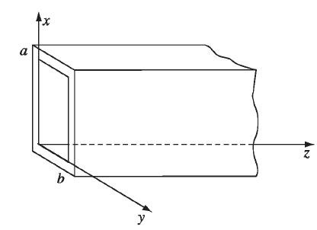
Waveguides (recap) [1]
TE Solutions of the form $B_{z}(x,y,z,t)=B_{0}\cos\left(\frac{mπx}{a}\right)\cos\left(\frac{nπy}{b}\right) e^{j(ωt−kz)}$
i.e. a fwd travelling wave
Cut off freqs:
$$ω_{mn}=cπ\sqrt{{\left(\frac{m}{a}\right)}^{2}+{\left(\frac{n}{a}\right)}^{2}}$$

Slide 7
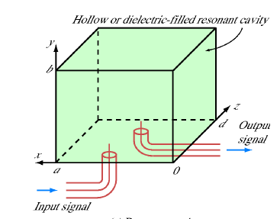
Cap the ends with metal plates [2]
$$B_{z}=\left(B_{0}^{+}e^{−jkz}+B_{0}^{−}e^{jkz}\right)\cos\left(\frac{mπx}{a}\right)\cos\left(\frac{nπy}{b}\right)e^{jωt}$$
Fwd and bkwd waves
Boundary conditions at $z=0, z=d$:
$${\left(∇×\vec{E}\right)}_{z}=−{jωB}_{z} \\ =\frac{∂E_{x}}{∂y}−\frac{∂E_{y}}{∂x} \\ =0$$

Slide 8
Cap the ends with metal plates [2]
This implies that $B_{0}^{+}=−B_{0}^{−} , kd=pπ$ and : $B_{z}={−2jB}_{0}^{+}sin\left(\frac{pπz}{d}\right)\cos\left(\frac{mπx}{a}\right)\cos\left(\frac{nπy}{b}\right)e^{jωt}$
The frequency of a waveguide mode earlier was $ck=\sqrt{ω^{2}−ω_{mn}^{2}}$
Now, k is restricted, so
$$ω_{0}=cπ\sqrt{{\left(\frac{p}{d}\right)}^{2}+{\left(\frac{m}{a}\right)}^{2}+{\left(\frac{n}{b}\right)}^{2}}$$
Waveguide frequency

Slide 9
Losses in a resonator
Perfect metal $⟶$ No losses
Finite $σ$ $⇒$ Boundary conditions get slightly modified $⇒$ System supports small range of frequencies around $ω_{0}$

Slide 10
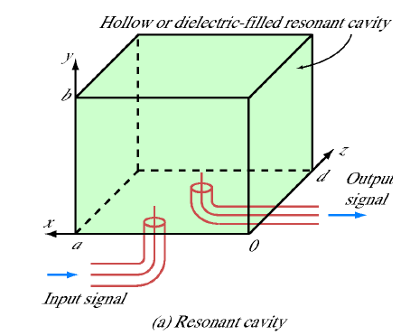
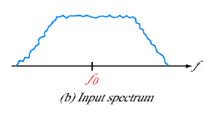
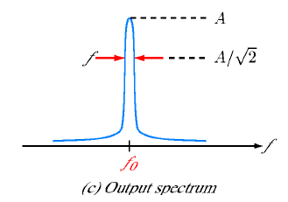
Waveguide resonator [2]
$$Q=ω_{0}\frac{Energy Stored}{Power lost}$$

Slide 11
Waveguide resonator [2]
$$Q≈\frac{ω_{0}}{Δω}$$
Calculating resonator loss allows Q calc.

Slide 12
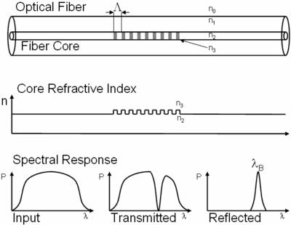
Resonators in the real world
Fiber-Bragg mirrors [3]

Slide 13
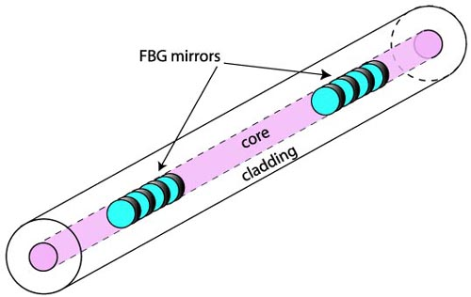
Resonators in the real world
Fiber-based resonator [4]

Slide 14
Laser Physics in brief [5]

Slide 15
Laser Physics in brief [5]
Fast
Slow
The presence of a photon encourages another photon to be emitted: Stimulated emission
Only 2 level system, $\frac{N_{2}}{N_{1}}=exp⁡(−\frac{ΔE}{kT})$

Slide 16
Laser Physics in brief [5]
So, the resonant frequency of the resonator must match the energy transition of the gain/laser medium!

Slide 17
Laser Physics in brief [5]

Slide 18
Laser Physics in brief [5]

Slide 19
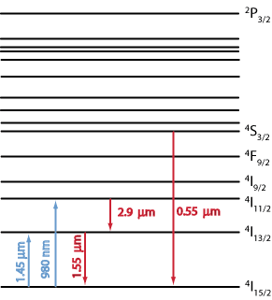
Gain medium in the fiber? [6]
Introduce a rare Earth ion into the fiber: Called “doping” – Erbium Doped Fiber
Energy band diagram of $Er^{3+}$

Slide 20
Applications [7]
As a gain medium in a fiber-laser
As an amplifier in fiber optics: backbone of ALL telecom!

Slide 21
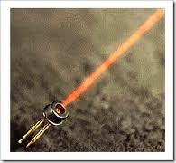
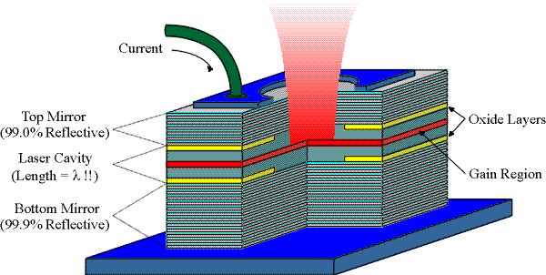
VCSEL
Vertical Cavity Surface Emitting Laser [8]

Slide 22
Electro-optic modulator

Slide 24
GRACE mission (NASA) [9]

Slide 25
GRACE mission (NASA) [9]
Revealed ground water depletion over North India to be 1 ft (2002-08)

Slide 26
References
[1] Griffiths, Introduction to Electrodynamics, 4th Ed.
[2] Ulaby et al., Fundamentals of applied electromagnetics, 6th Ed.
[3] http://www.hoestarinsp.com.sg/FBG1-large.jpg
[4] http://spie.org/x8609.xml
[5] http://www.orc.soton.ac.uk/61.html
[6] http://www.rp-photonics.com/erbium_doped_gain_media.html
[7] http://www.rp-photonics.com/erbium_doped_fiber_amplifiers.html
[8] http://japaneseclass.jp/trends/about/VCSEL [9] http://www.csr.utexas.edu/grace/

