Slide 1
EEL 207
Why Study Electromagnetics?
Uday Khankhoje
Electrical Engineering
IIT Delhi, 2014-15

Slide 2
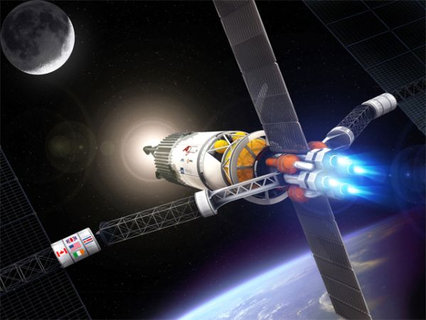
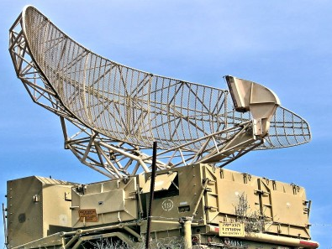
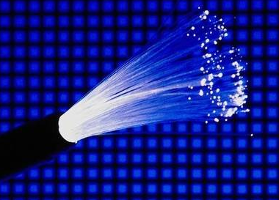
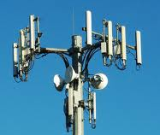
Why Study Electromagnetism?
Plasma propulsion
Radars
Cell
towers
Optical
fibres

Slide 3

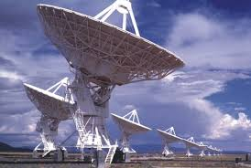
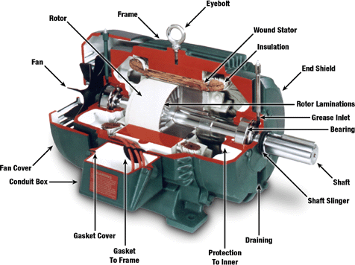
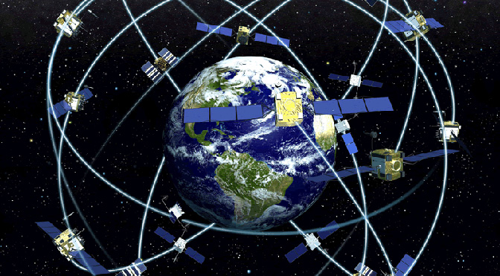
Why Study Electromagnetism?
LCD
screens
Radio astronomy
GPS
Motors

Slide 4
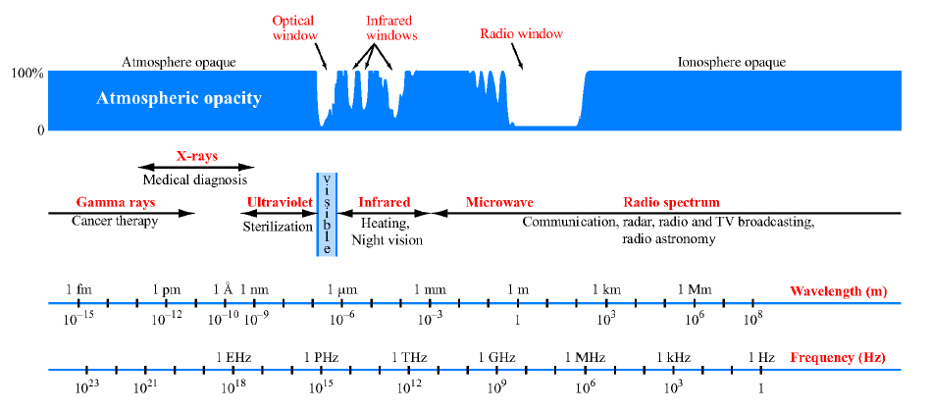
Electromagnetic Spectrum
[8]

Slide 5
EM Applications over time
1900 – 1990s: Dominated by military applications – Radar, stealth technology, electromagnetic weapons, etc.
1990s – today:
  Computing
  Communication
  Imaging (bio-medical, remote-sensing, ground-penetrating radar, oil well exploration, etc.)

Slide 6
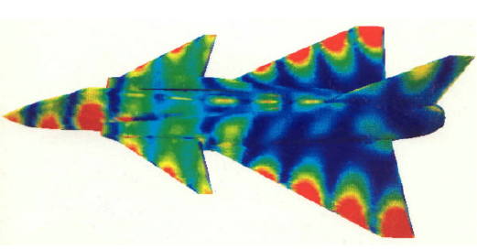
Military applications
[1]
100 MHz radar wave interacts with a fighter jet. False colours correspond to induced surface currents which re-radiate EM energy

Slide 7
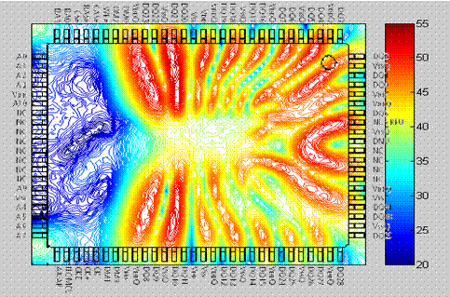
High-speed circuits
Circuit theory is actually a subset of electromagnetic field theory:
At high switching speeds, signals are not confined to circuit paths!
Shrinking circuit size + high speed operation => Higher coupling between circuit elements via EM
Near magnetic field above a packaged integrated circuit.[2]

Slide 8
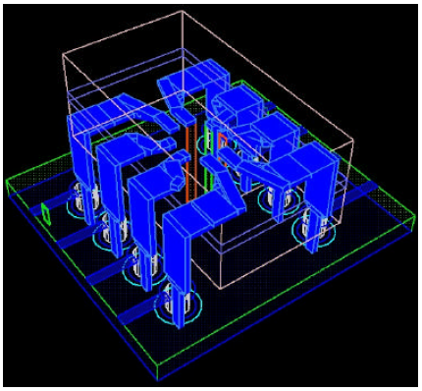
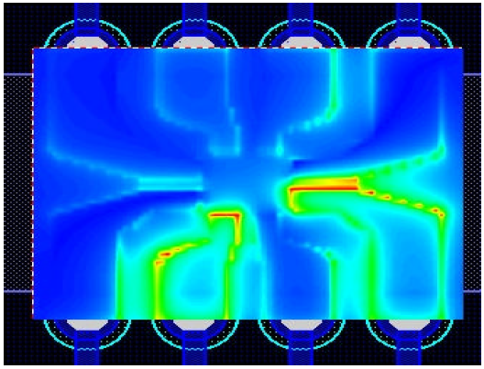
High-speed circuits
Microchip embedded within a dual inline IC
[1]
Fields associated with a logic pulse are not confined to metal paths

Slide 9
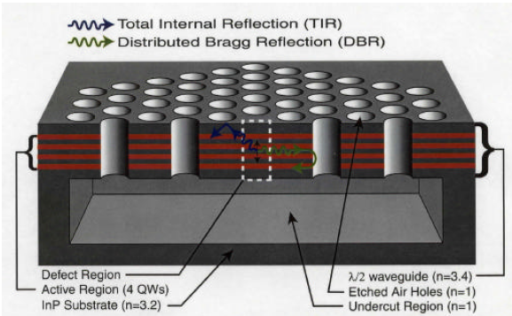
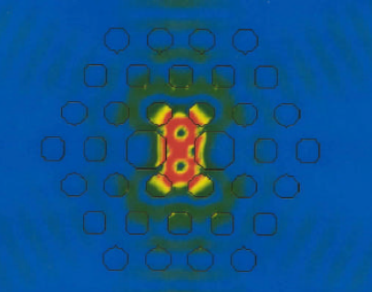
Micro-cavity Laser Design
Periodic air holes in a slab – Photonic Crystal
Simulation showing trapped electro-magnetic fields
[7]
Used for making ultra-compact lasers, quantum-entanglement devices, etc.

Slide 10
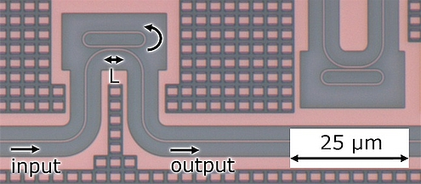
Photonic integrated circuits
[5]
Circuits for light : simple example of a wavelength dependent filter. At the resonance frequency of the loop, output drops off.

Slide 11
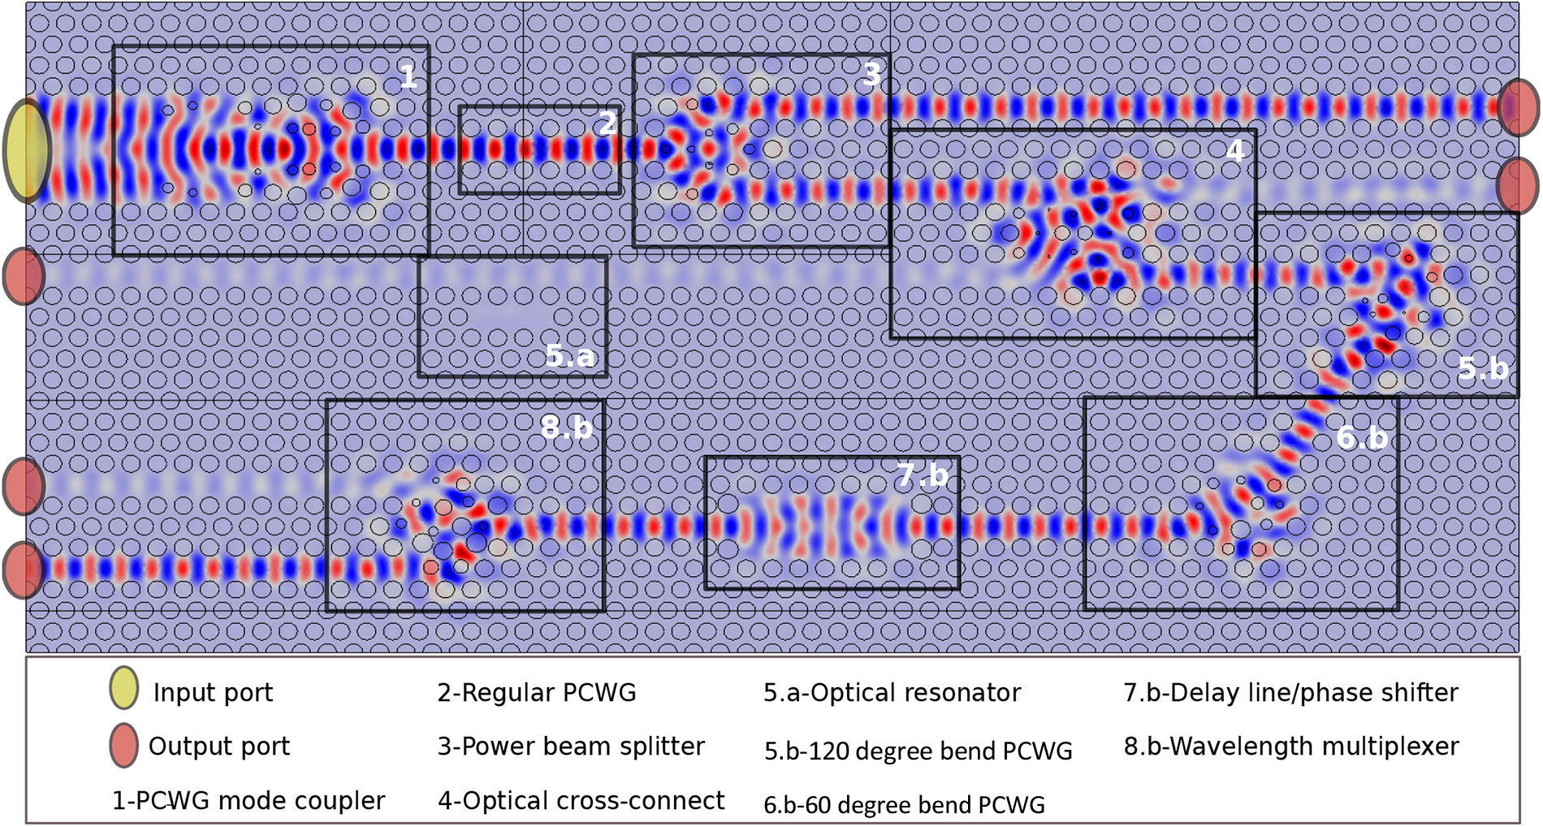
Photonic integrated circuits
[6]

Slide 12
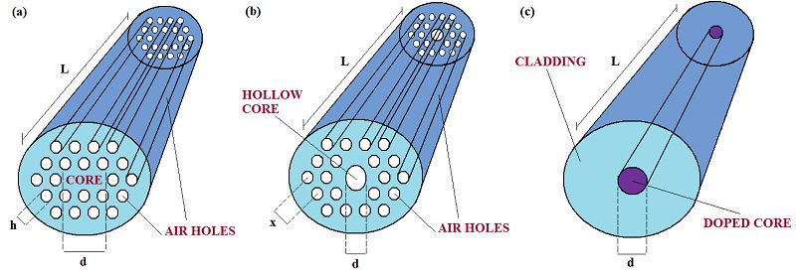
Optical Fibres
[4]
Photonic crystal fibres
Conventional fibres
In addition to simply guiding light, gives control over dispersion, polarization properties, non-linear effects, etc.

Slide 13
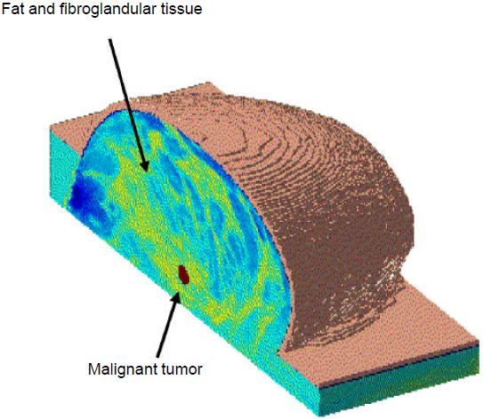
Human Body Imaging : medicine
Tumour region has different refractive index as compared to surrounding fatty tissue
[1]
Surround the tissue by antennas: properties of the scattered electro-magnetic energy depends on refractive index distribution
Reconstruct refractive index profile based on scattered electro-magnetic fields

Slide 14
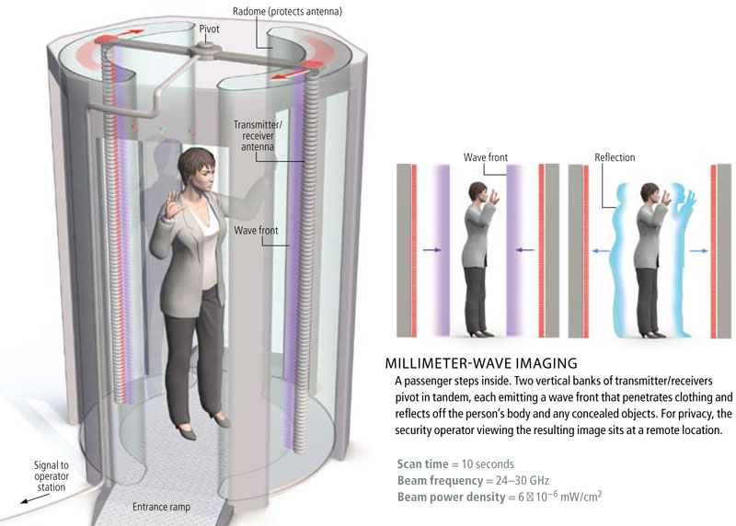
Human Body Imaging : security
Very active area of research : terahertz frequency (millimetre wavelength) sources and detectors.
[3]

Slide 15
Conclusions
Study of EM is fundamental to most applications of computing, circuit design,
and communications
Many prominent future technologies are highly dependent on a sound understanding of EM: quantum computing, high-speed optical inter-connects, wireless power transfer

Slide 16
References
[1] Taflove, Allen. "Why study electromagnetics: the first unit in an undergraduate electromagnetics course." Antennas and Propagation Magazine, IEEE 44.2 (2002): 132-139.
[2] http://www.cvel.clemson.edu/emc/ic_emc/ic.html
[3] http://projektas-kalejimai.blogspot.in/2011_11_01_archive.html
[4] http://www.intechopen.com/books/advances-in-photonic-crystals/photonic-crystals-for-optical-sensing-a-review
[5] http://www.tnw.tudelft.nl/en/about-faculty/departments/imaging-physics/research/researchgroups/optics-research-group/research/integrated-photonics/
[6] Imanol Andonegui and Angel J. Garcia-Adeva. “Designing integrated circuitry in nanoscale photonic crystals” http://spie.org/x104683.xml
[7] O. Painter, R. K. Lee, A. Scherer, A. Yariv, J. D. O’Brien, P. D. Dapkus, and I. Kim, “Two-dimensional photonic band-gap defect mode laser,” Science, vol. 284, June 11, 1999, pp. 1819–1821.
[8] Ulaby, Michielssen, Ravaioli, “Fundamentals of Applied Electromagnetics”, Pearson 6th ed.

