Slide 1
Computational Electromagnetics
& Remote Sensing
Uday Khankhoje,
Electrical Engineering, IIT Madras
uday@ee.iitm.ac.in

Slide 2
The Roadmap
Microwave remote sensing and the Synthetic Aperture Radar (SAR)
Why we care? Context of upcoming NASA-ISRO mission: NISAR
Electromagnetic and signal processing framework for SAR
Examples
  soil moisture detection
  vegetation analysis
  deformation studies of Earth’s surface

Slide 3
Remote Sensing: Various types
Optical, Infrared: e.g. Google satellite view photos, Hubble space telescope
Microwave: estimation of soil moisture, ocean wind speed etc, creating digital elevation maps.
Active: Satellite is source of illumination
Passive: Some other source (usually the sun)

Slide 4
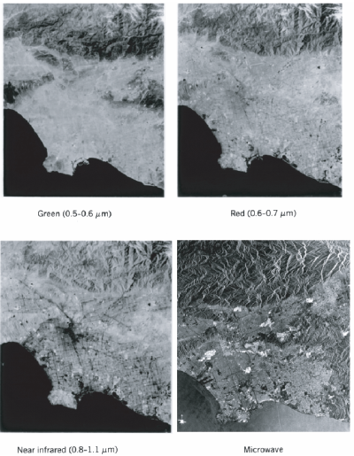
Microwave remote sensing offers all-weather capability

Slide 5
Making it specific …
We will focus on active microwave remote sensing in the remainder of this tutorial.
Change radar wavelength => we can access different parts of the Earth’s surface

Slide 6
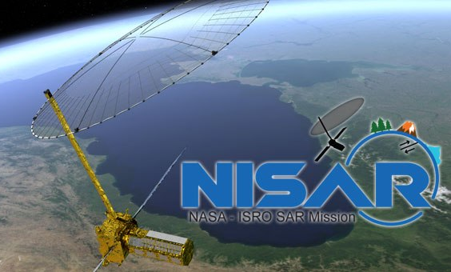

Why is this important?
NASA-ISRO joint mission, NISAR will be launched in 2020.
NISAR tech specs:
  L & S band radars (first time ever dual band)
  Fully polarimetric : 165 Watts / pol
  12 day repeat orbit
  3-10m resolution
  750 km orbit height

Slide 7
Why is this important?
Huge amounts of data will be generated, on a global scale
Big opportunity to study:
  Earth surface: Surface deformation to determine the likelihood of earthquakes, volcanic eruptions, and landslides, and monitor groundwater, hydrocarbon, and sequestered CO2 reservoirs
  Cryosphere: determine how climate and ice masses interrelate and raise sea level and measure changes in sea ice, snow extent, permafrost, and surface melting.
  Ecosystems: determine the contribution of Earth's biomass to the global carbon budget and characterize ecosystem disturbance and impacts on biodiversity.
  Water: determine aquifer extent and change over the Earth's vulnerable water systems.
Indian academia is quite unprepared to meet the challenge

Slide 8
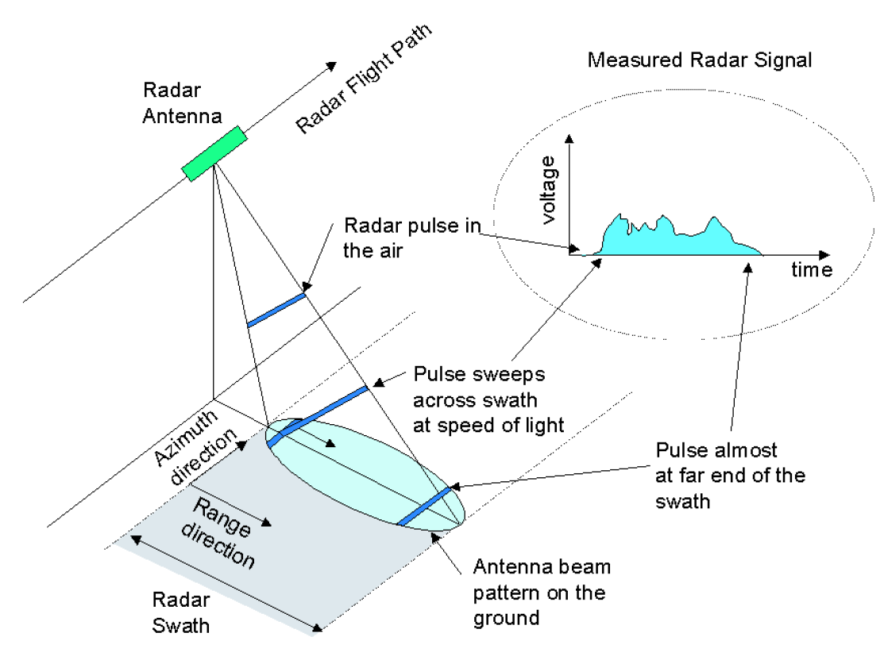
Nomenclature and geometry

Slide 9
Range Resolution

Slide 10
Range resolution

Slide 11

Range resolution
Putting it together, the ground resolution becomes
$x_{g}=\frac{x_{r}}{\sin{θ}}=\frac{cτ}{2sinθ}$
Approximating pulse band-width as $B=1/τ$ gives the ground resolution as
$x_{g}=\frac{c}{2Bsinθ}$
Small $τ$ implies lower SNR, but poorer range resolution

Slide 12

Range Resolution
Instead use a longer pulse, but modulate it, e.g. a chirp. Net result: SNR is good, and B also high.
$f\left(t\right)=f_{0}+\frac{B}{τ}t, −\frac{τ}{2}<t<\frac{τ}{2}$
Now, the echoes from two targets may overlap in time, but they get returned at different frequencies
=> Frequency filtering helps to recover resolution
Matched filter: convolve return signal with a replica of transmitted signal: $[Rp\left(t−t_{0}\right)∗p\left(t\right)]$
Resolution depends on B, not pulse length $τ$
Typically: $τ$ ~tens of $μ$s, B ~tens of MHz

Slide 13
What about azimuth resolution?

Slide 14
Real aperture radar

Slide 15
Solution: Synthetic Aperture Radar

Slide 16

SAR – utilizing Doppler
If $R(t)$ is the range at any point, then received signal is $ψ\left(t\right)∝exp⁡[−j\frac{2π}{λ}\left(2R\left(t\right)\right)]$ (ignoring other factors)
Due to satellite motion, say velocity $v$,
$R\left(t\right)$ changes as $R{\left(t\right)}^{2}=R_{0}^{2}+{\left(vt\right)}^{2}$
Since $R_{0}≫vt$, we have $R\left(t\right)≈R_{0}+\frac{{\left(vt\right)}^{2}}{2R_{0}}$

Slide 17

SAR – utilizing Doppler
Inst. frequency is $f\left(t\right)=\frac{1}{2π}\frac{dφ\left(t\right)}{dt}=−\frac{2jv^{2}t}{R_{0}λ}$
Total time object is in beam?
$(Distance)/(speed)=\frac{R_{0}(λ/L)}{v}=\frac{R_{0}λ}{Lv}$
Bandwidth is ${B_{D}=|f}_{max}−f_{min}|=\frac{2v}{L}$
Using a matched filter, signal duration
of processed pulse: $τ≈1/B_{D}$

Slide 18

SAR – utilizing Doppler
Two points separated along azimuth by: $x_{a}=vt$
Min separation s.t. they can be resolved: $x_{a}=vτ=\frac{L}{2}$
Remarkable result: Resolution independent of wavelength!
But, no free lunch as small length also => poor SNR

Slide 19
SAR processing challenges
Inadequate pulse repetition frequency (PRF) can cause aliasing of the image, seen above.

Slide 20
SAR imaging artifacts

Slide 21
SAR images: speckle
Average the scene over many “looks” to reduce speckle noise.
Leads to some loss of resolution

Slide 22
SAR Polarimetry

Slide 23
SAR Polarimetry

Slide 24
Power of SAR polarimetry

Slide 25
End of introduction

Slide 26

Major classes of scatterers
Bare, rough soils
Crop covered soils
Forests (different kinds)
Urban areas
Water bodies
In each of the above cases, $ε(r)$ for each object is different, and hence radar scatter changes.

Slide 27
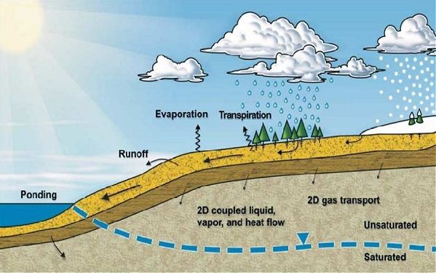
Important example: soil moisture
Role in water cycle; input parameter to climate models
[Vadose Zone Modeling with VADOSE/W; Krahn 2004, Geo-Slope.]

Slide 28
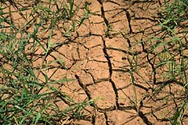
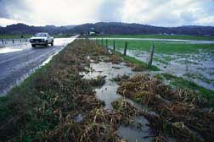
Important example: soil moisture
Important for crop yield prediction;
especially for places with scarce availability of water
For places with excess rainfall; important for flood prediction and disaster management

Slide 29
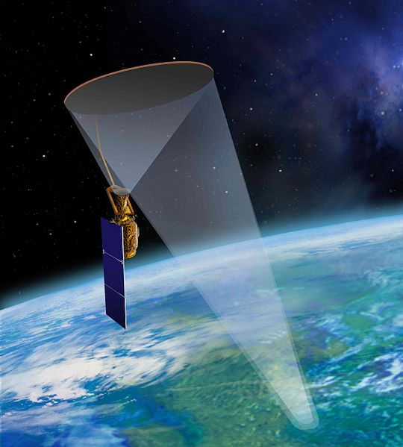
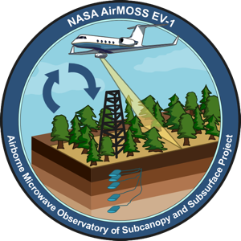
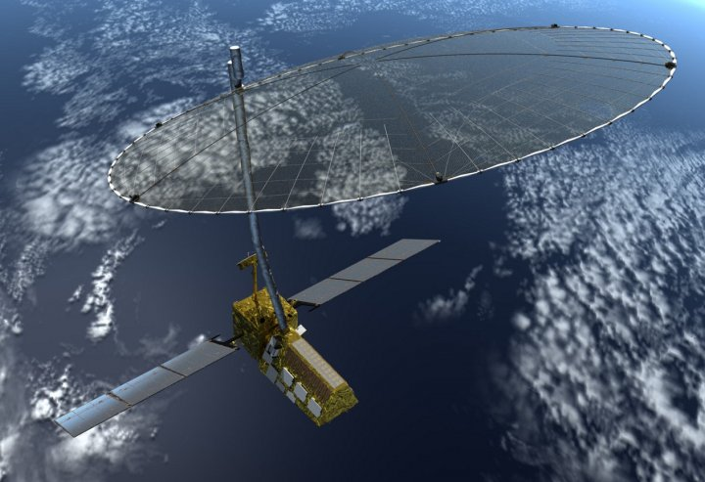
Soil Moisture Missions
Aircraft based mission in progress (AirMOSS)
P-band
Satellite based
mission launched
in 2014 (SMAP)
L-band
NASA-ISRO mission (NISAR)
L&S band – 2020 launch

Slide 30

Analyzing bare rough soils
Complication: statistic of soil surface also influence radar backscatter, $σ_{s}$
For e.g. surface roughness, or correlation length have a strong impact on $σ_{s}$

Slide 31
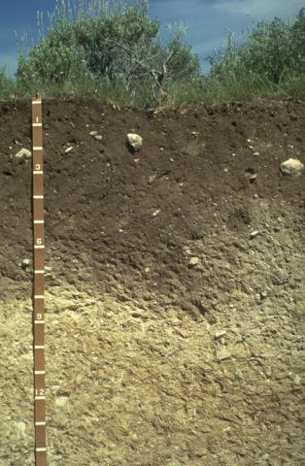
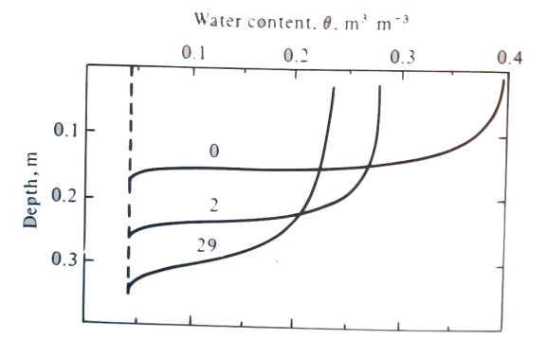
In real life …
Soil can be heterogeneous in:
Composition,
Moisture content,
especially after rainfall/irrigation
[http://soils.cals.uidaho.edu/
soilorders/orders.htm]
Soil Physics; Marshall et. al., Cambridge UP, 1996.

Slide 32
In real life …
Soil can be heterogeneous in:
Composition,
Moisture content,
especially after rainfall/irrigation
Analytical and semi-analytical methods fail to address this challenge when interfaces are rough
Solution: A fully numerical tool such as the
Finite Element Method
[http://soils.cals.uidaho.edu/
soilorders/orders.htm]

Slide 33
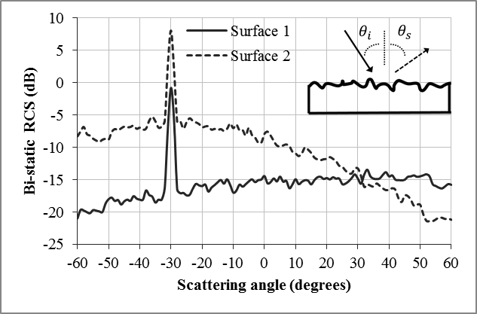
How do rough surfaces scatter?
Surfaces are treated as random processes characterized by:
Roughness
Correlation length
Correlation type

Slide 34
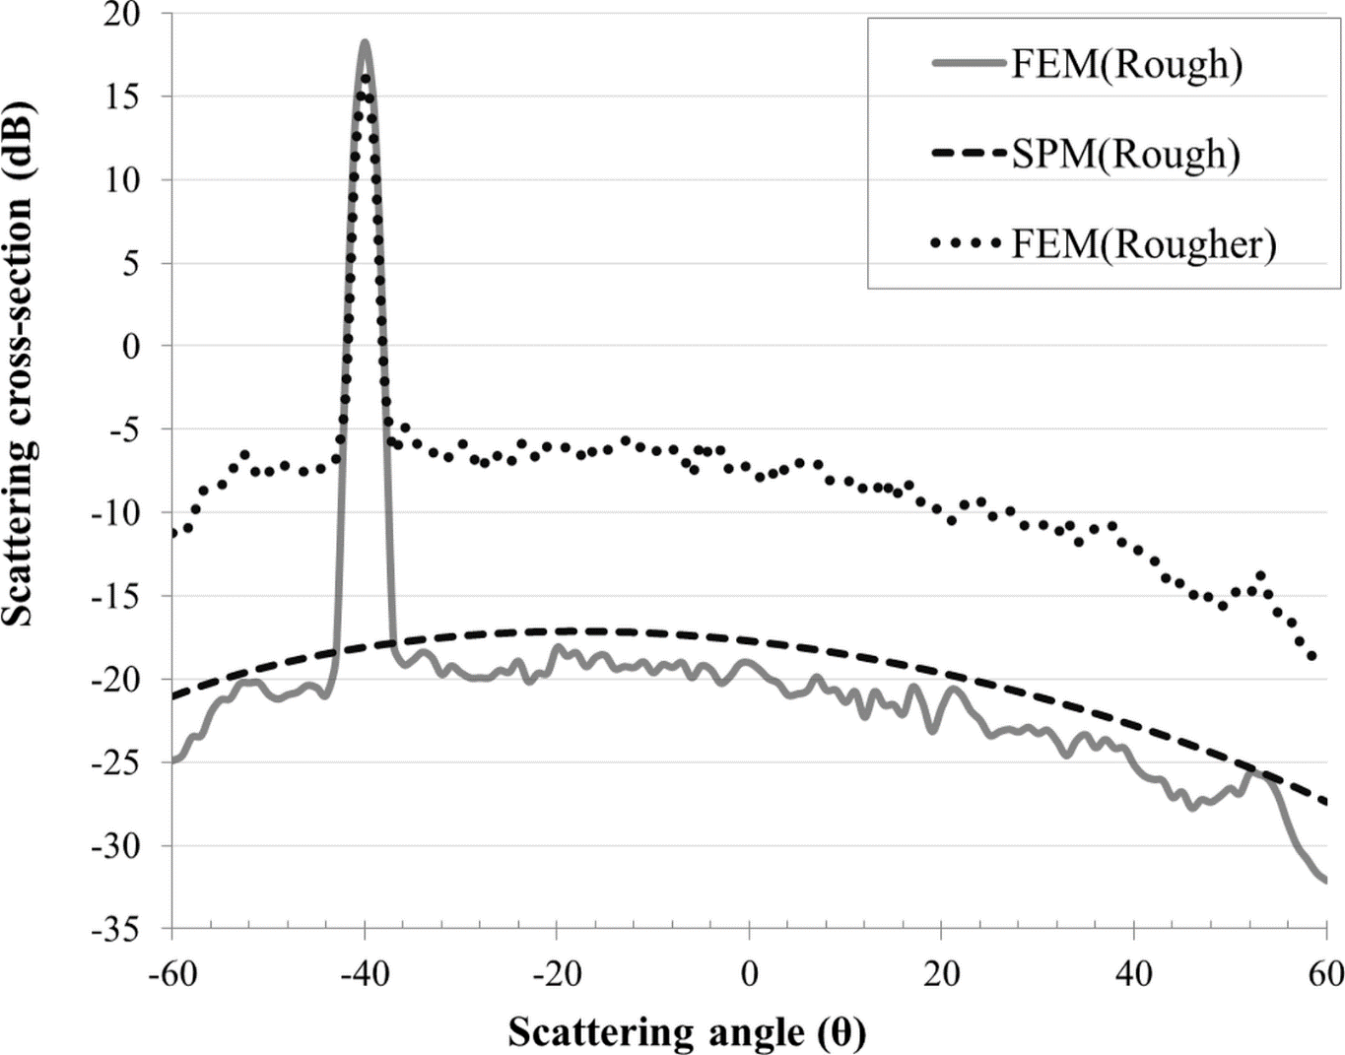
Impact of Soil Roughness
inc
scat
θ
40º TE incident field
15% soil moisture
(silt loam soil).
Rougher soil (FEM)
Rough soil (FEM)
Rough soil (SPM)
(semi-analytic)
λ=24 cm, Gaussian soil,
{rough: kh=0.5, s=20º,
rougher: kh=0.1, s=5º }

Slide 35
Impact of Soil Moisture
Logarithmic relation between moisture and back-scatter.
Fit parameters depend on soil surface statistics
(roughness, correlation length)
λ=24 cm, inc = 40º, Gaussian soil, {kh=0.5, s=20º}.

Slide 36
Soil moisture : data cube approach
Physics parameters of soil
Radar scattering cross-section:
Polarizations
&
Phase
Data Cube
roughness
Soil moisture
Incidence angle
Data cube is pre-computed
A look-up is performed to estimate soil moisture
[Current baseline algorithm for SMAP]

Slide 37
Heterogeneous soil
Soil moisture
Variable
moisture
d
Depth
Constant
moisture
Study the role of:
Wetting or Drying profile
Depth to constant moisture

Slide 38


Hetero Soil – Radar Return ($σ_{s}$)
Blue, red curves:
Wetting profiles
45%(top) ➔ 25% (bot)
Green, purple curves:
Drying profiles
5%(top) ➔ 25% (bot)
$σ_{s}$ if const 45%
$σ_{s}$ if const 25%
$σ_{s}$ if const 5%
TM (H-pol), λ= 24cm, inc = 40º,
{ Gaussian rough soil: kh=0.1, s=5º}

Slide 39
Hetero Soil – Radar Return ($σ_{s}$)
Conclusion
Radar is very sensitive to top λ/2 of soil.
Making assumption of constant soil moisture can lead to large errors,
esp. for drying soils
Date cube FAIL!
TM (H-pol), λ= 24cm, inc = 40º,
{Gaussian rough soil: kh=0.1, s=5º}

Slide 40

How to compute?
Start with Maxwell’s equations
$∇×\vec{H}\left(r\right)=jw ε\left(r\right) \vec{E}\left(r\right)$
$∇×\vec{E}\left(r\right)=−jw μ\left(r\right) \vec{H}\left(r\right)$
Recall $∇ : \frac{∂}{∂x} \hat{x}+\frac{∂}{∂y} \hat{y}+\frac{∂}{∂z} \hat{z}$
Combine it into a single equation
$∇×\left(\frac{1}{ε_{r}(r)}∇×\vec{H}\left(r\right)\right)=k_{0}^{2 }μ_{r}\left(r\right) \vec{H}\left(r\right)$

Slide 41
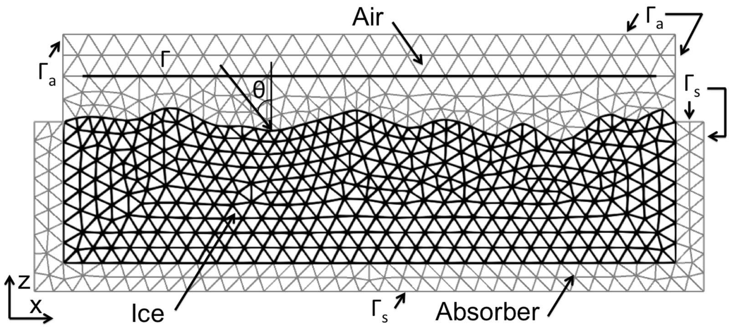
How to compute: FEM
Solve
in each

Slide 42
FEM : Basis Elements
In each element, field is expanded along Whitney basis
Each basis element has:
Constant tangential component along one edge.
Only normal component along other edges.
(Constant curl)
3 unknowns per element
U₁
U₂
U₃
Finite Element Analysis of Antennas and Arrays, J-Ming Jin and DJ. Riley, Wiley 2009

Slide 43
FEM : Galerkin Method
Take the wave equation:
Enforce it in a weak sense:
Unknown field:
Expanded in terms of Whitney basis functions.
Testing function:
Chosen to be one of the basis functions.
By having T cycle through the set of basis functions
we get N equations in N variables. Sparse system.

Slide 44
FEM : Boundary Conditions
Recast equation to delineate contributions from
interior and boundary:
Boundary condition should minimize numerical reflection
Air
Soil

Slide 45
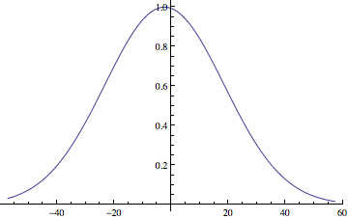
FEM: Implementation
Incident field needs to be tapered:
  Reduce edge diffraction
  Minimize error from boundary
  conditions
|E|
g
Gaussian amplitude with
beam waist g.
Satisfies the wave equation
to order 1/(k₀g cosθ)²
x
The validity of the Kirchhoff approximation for rough surface scattering
using a Gaussian roughness spectrum; E Thorsos, JASA, 1988.

Slide 46
FEM : Implementation
Each edge length must be < λ/20
(λ in the medium)
Sparse system solved using open-source
Matrix MUMPS library
~1,500,000 x 2 unknowns takes
< 2 min, < 2 GB RAM on 3 GHz CPU
Many open-source sparse solvers available
  Either direct solvers (small problem size)
  Or iterative solvers (larger problems)

Slide 47

FEM : Monte Carlo
Challenge is unique to remote-sensing:
One computation is not good enough
Statistical properties are desired:
Ensemble average over $≈100$ instances
Each instance – Unique mesh 8 min per mesh generation, $≈$1 min to solve
Mesh changes only slightly / instance. Inefficient! => Presents a research opportunity, else methods will not be adopted by the community

Slide 48
Studying vegetated areas

Slide 49

Review: SAR Polarimetry
Important to keep the wave picture in mind (ray picture fails as obj. $l \sim λ$)

Slide 50

Review: SAR Polarimetry
$$χ :Ellipticity angle \\ ψ :Ellipse Orientation angle$$

Slide 51
Representing scatterers: linear pol
1. Scattering matrix [S], and both polarizations:
2. Received voltage in terms of polarizations of Tx,Rx antennas:

Slide 52
Multi-look averaging
3. Gives Rx power as:
Covariance matrix
4. Simplifies to:
5. Rx/Tx antenna polarizations remain same, [C] is averaged:

Slide 53
Examples: Dihedral corner reflector and vertical cylinder
Scattering
matrix
Covariance
matrix

Slide 54
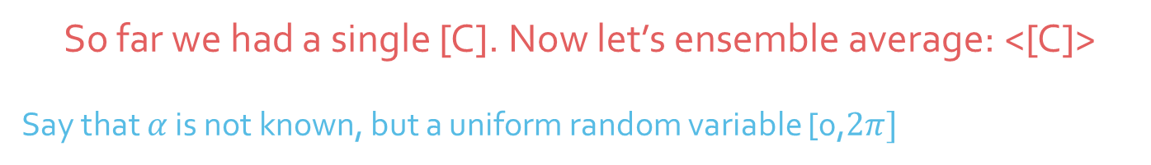

Cylinders (imp for vegetation)
Rotate by $α$ about vertical
So far we had a single [C]. Now let’s ensemble average: <[C]>
Say that $α$ is not known, but a uniform random variable [0,$2π]$

Slide 55

Scattering from the ground
(simpler model than FEM)
Small perturbation method (SPM, 1951 by S. Rice)
Solve Maxwell’s equations with a bare rough interface between air-soil
Assuming low roughness, the equations can be approximated in closed-form
        Gives avg. radar backscatter in terms of soil $ε$, incidence angle $θ$, mean roughness $h$, and surface correlation length, $l$, and $λ$

Slide 56
Scattering from the ground
(simpler model than FEM)

Slide 57
Something to ponder ..
Observation: All the scattering examples considered so far contain physical details of the scatterers.
Example: dihedral/cylinder dimensions, soil roughness
The promise of remote sensing is to infer interesting quantities from space without ground visits
So how can this be accomplished?

Slide 58
Decomposition models for SAR data
There are many sophisticated models that attempt to solve this problem
We will discuss the simplest of them, by building on the already discussed models
The approach is based on:
Freeman, Anthony, and Stephen L. Durden. "A three-component scattering model for polarimetric SAR data." IEEE Transactions on Geoscience and Remote Sensing 36.3 (1998)

Slide 59
Three-component scattering…
Radar return is theorized to be an incoherent sum of:

Slide 60
Cylinders – 1
Assuming uniformly random cylinders, we find the components of the averaged covariance matrix
Doing this carefully, we get:

Slide 61
Double Bounce – 2
Earlier we had:
Now generalize to:
Allow ground &
trunk to have diff.
refl. coefficients
and
attenuation through
canopy

Slide 62
Ground backscatter – 3
Use the SPM model (also called 1st order Bragg). Recall:
Gives us covariance matrix components as:
IMP: We don’t assume any of the surface properties are known

Slide 63

Add it all up …
$f_{d}$ $f_{v}$ $f_{s}$
This is the net, normalized
power seen by the radar
in each channel
4 Eqns in 5 unknowns

Slide 64

Add it all up …
Certain heuristic assumptions can be used to fix the value of $α,β$ in order to get 4 eqns/4 unknowns
Example of using this model over a test site in Germany using L-band SAR
Good for distinguishing vegetation cover types, also flooding in fields
Moreira, Alberto, et al. "A tutorial on synthetic aperture radar." IEEE Geoscience and remote sensing magazine 1.1 (2013): 6-43.

Slide 65
Extending it…
A new “helix” scattering term also helps distinguish urban areas from natural areas

Slide 66
Earth deformation studies

Slide 67
Oil spill detection & mapping
Moreira, Alberto, et al. "A tutorial on synthetic aperture radar." IEEE Geoscience and remote sensing magazine 1.1 (2013): 6-43.

Slide 68
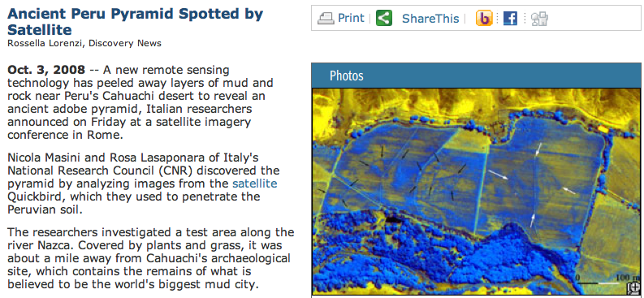
Buried pyramid detection
Quickbird has 60 cm radar plus optical/IR frequency sensors.

Slide 69

SAR interferometry
Recap: Maxwell’s equations lead to the wave equation $∇^{2}E=\frac{∂^{2}E}{∂t^{2}}$ , which gives harmonic solutions of the form $E=E_{0}exp⁡[j\left(kr−ωt+φ\right)]$
In SAR interferometry,
  Use 2 radars instead of 1,
  Phase difference between the fields
  measured by both radars depends
  on the relative path difference
Even though both radars are 100s of Km, path difference on the order of $λ$ can be measured

Slide 70

Interferometry Geometry
Individual phases are:
$$φ_{1}=\frac{4π}{λ}ρ, φ_{2}=\frac{2π}{λ}\left(2ρ+δρ\right)$$
Usually, $B≪ρ$, Cosine Law gives:
${\left(ρ+δρ\right)}^{2}=ρ^{2}+B^{2}−2ρB\cos\left(\frac{π}{2}−θ+α\right)$
$Δφ≈−\frac{2π}{λ}B\sin{(θ−α)}$

Slide 71

Phase plot for flat Earth
$$Δφ≈−\frac{2π}{λ}B\sin{(θ−α)}$$

Slide 72
Effect of wavelength
$$Δφ≈−\frac{2π}{λ}B\sin{(θ−α)}$$

Slide 73
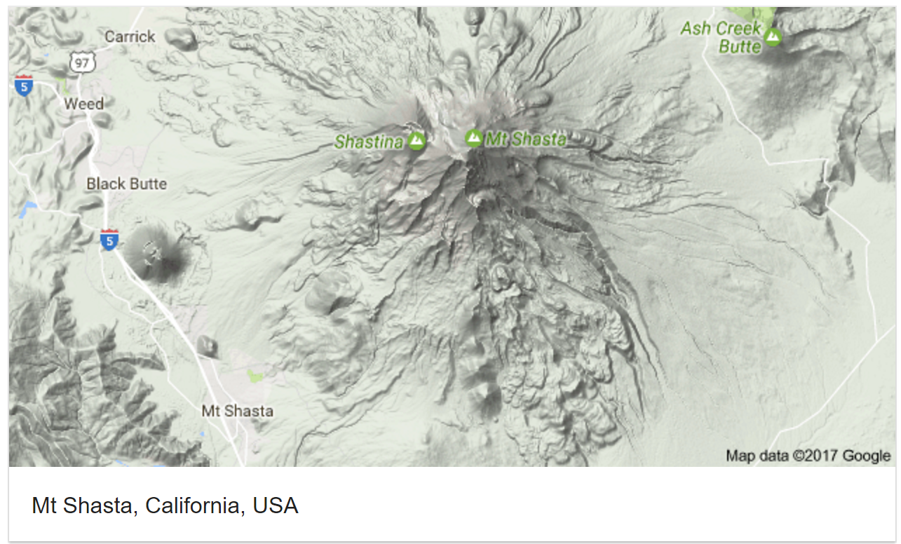
Example: Mt. Shasta
3D digital elevation model below:

Slide 74
Interferogram for Mt Shasta

Slide 75

Remove “flat” Earth
$θ_{0}$ be a point on flat Earth
Earlier term: $\sin{(θ−α)}$ gets re-written as: $\sin{(θ_{0}+δθ−α)}$
Simplify interferometric phase:
$Δφ=\frac{2πB}{λ}[\sin\left(θ_{0}−α\right)−δθ\cos\left(θ_{0}−α\right)]$
First term is constant: “Flat” Earth
$Δφ_{flat}=−\frac{2πB}{λ}δθ cos\left(θ_{0}−α\right)$

Slide 76
“Flattened” interferogram

Slide 77

Sensitivity to topography
Objective is to find the height of the surface, $z(y)$
Simple geometry gives:
$δθ≈\frac{z\left(y\right)}{ρ\sin{θ_{0}}}$
And $Δφ_{flat}=−\frac{2πB}{λ}δθ cos\left(θ_{0}−α\right)$
Ambiguity if $Δφ$ exceeds $2π$
$$h_{a}=\frac{λρ\sin{θ_{0}}}{B\cos{(θ_{0}−α)}}$$

Slide 78
Sensitivity to topography
Smaller ambiguity height => Better resolution, but the phase will get “wrapped” around
Active research area: phase unwrapping algorithms

Slide 79

Phase wrapping depends on $λ$

Slide 80
Example of phase unwrapping: DEM
Taken by TanDEM-X over Atacama desert in Chile
(a) With flat Earth, (b) after removal of flat earth
(c) after phase unwrapping

Slide 81
Two ways to implement InSAR

Slide 82
Single v/s Repeat pass InSAR
Single pass
Baseline known
Large baselines not possible
No temporal decorrelation
Higher cost and better performance
NISAR will do this!
Repeat pass
Baseline not well known/changing
Large baselines possible
High temporal decorrelation
Low cost

Slide 83
In summary, the possibilities are endless!

Slide 84

Further reading …
Most figures taken from these references with due credit to them, and to Jakob van Zyl

